Slide 1


TravelTide: Customer Segmentation Insights
Introducing TravelTide and its diverse customer base. Understanding segments helps tailor services and marketing to increase engagement and revenue.
by Uchechukwu Hoffmann

Slide 2


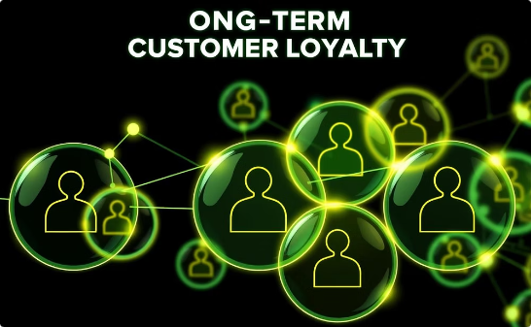
Vision & Mission
Strategic Retention
Personalized Rewards
Fostering Loyalty
Enhancing customer loyalty through data-driven strategies tailored to user behaviors.
Implementing customized rewards aligned with individual travel preferences and habits.
Building strong customer relationships for sustained engagement and growth.

Slide 3
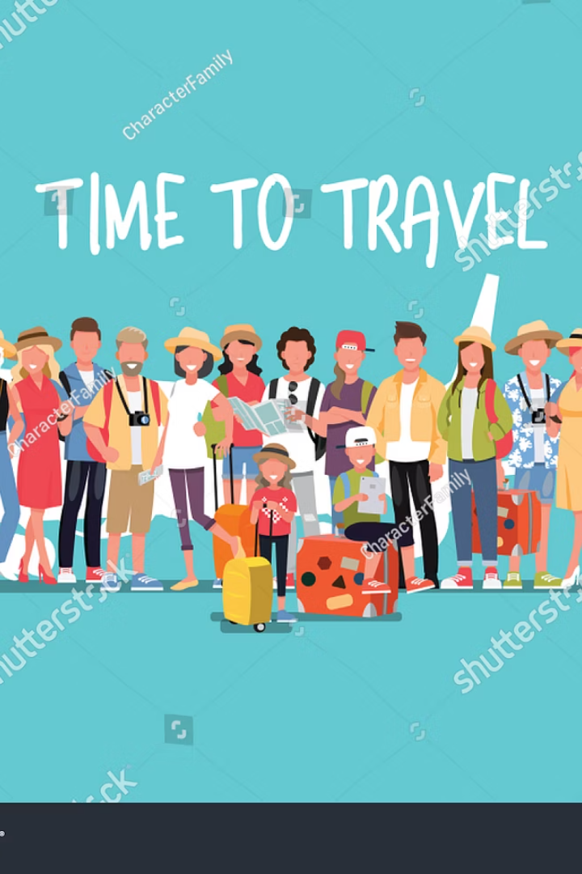
Customer Segmentation Overview
Family Travellers
Focus on group experiences and comfort
Young Adult Frequent Travellers
Seeking adventure and social connection
Dreamers
Casual browsers and aspirational planners
Senior Travellers
Leisure and comfort-focused travelers
Business Travellers
Efficiency and convenience prioritized
Young Frequent Travellers
Budget conscious, spontaneous trips

Slide 4
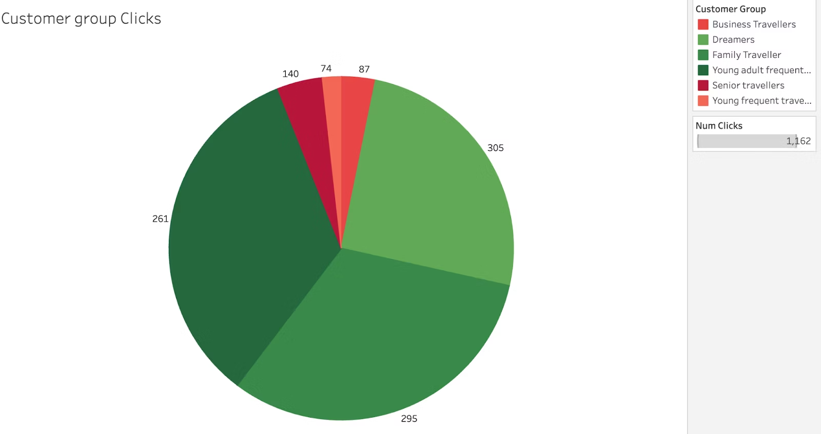
Customer Click Behavior
High Clicks
Low Clicks
Young Adults & Family Travellers — engaged users
Senior, Business & Young Frequent Travellers — limited interaction

Slide 5

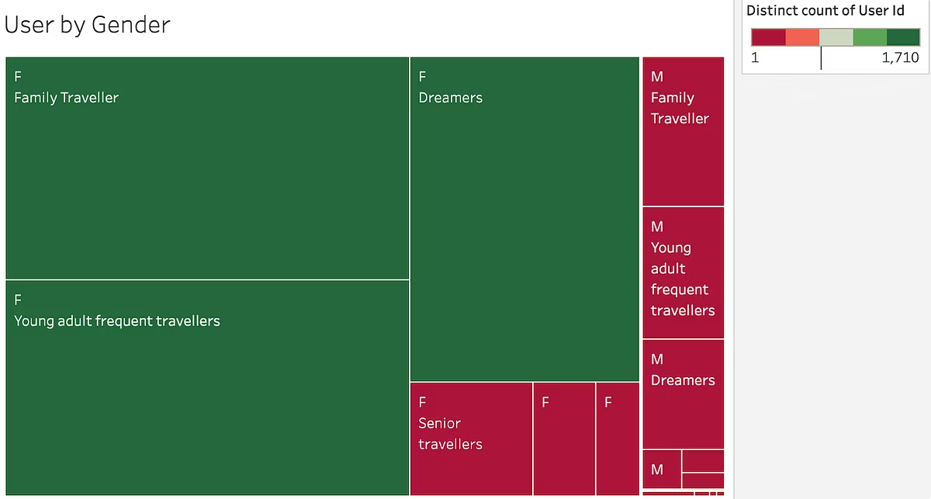
Gender Breakdown by Customer Segment
Predominantly Female
Mixed but Skew Female
Family and Young Adult Frequent Travellers
Dreamers segment
Predominantly Male
Business and Young Frequent Travellers

Slide 6
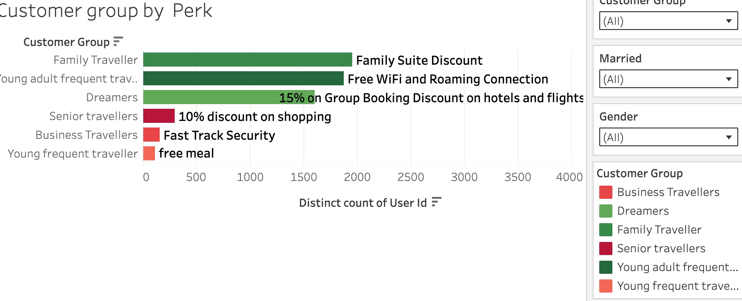
Perk Alignment by Segment
Family Travellers
Business Travellers
Family Suite Discounts
Fast Track Security
Dreamers
Young Frequent Travellers
Group Booking Discounts
Free Meals
Senior Travellers
Young Adult Frequent Travellers
Shopping Discounts
Free WiFi and Roaming

Slide 7
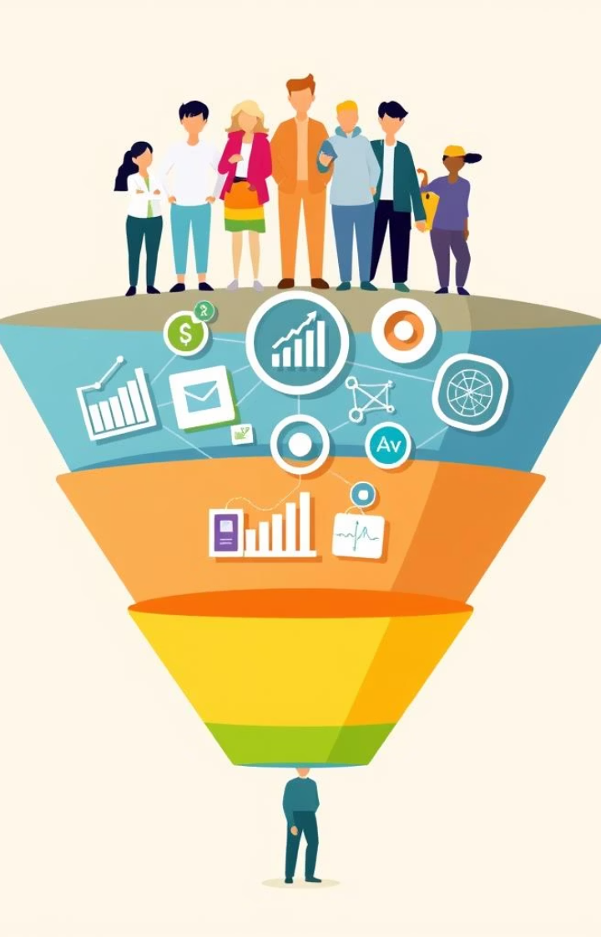
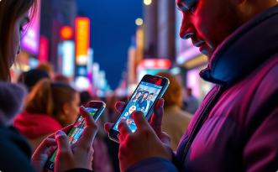

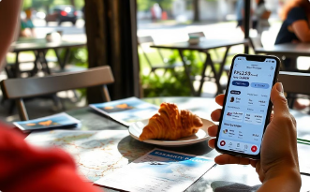
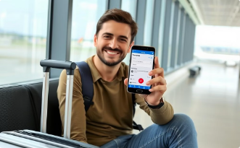

TravelTide Marketing Funnel
Awareness
Interest
Decision
Introducing TravelTide to potential customers through targeted campaigns.
Engaging users actively exploring travel options and staying informed.
Helping customers evaluate choices to find the perfect trip.
Conversion
Retention
Turning interest into confirmed bookings with a seamless experience.
Building loyalty through continued engagement and excellent service.
This funnel illustrates key stages of the customer journey, highlighting how TravelTide effectively engages and converts its audience at each step.

Slide 8

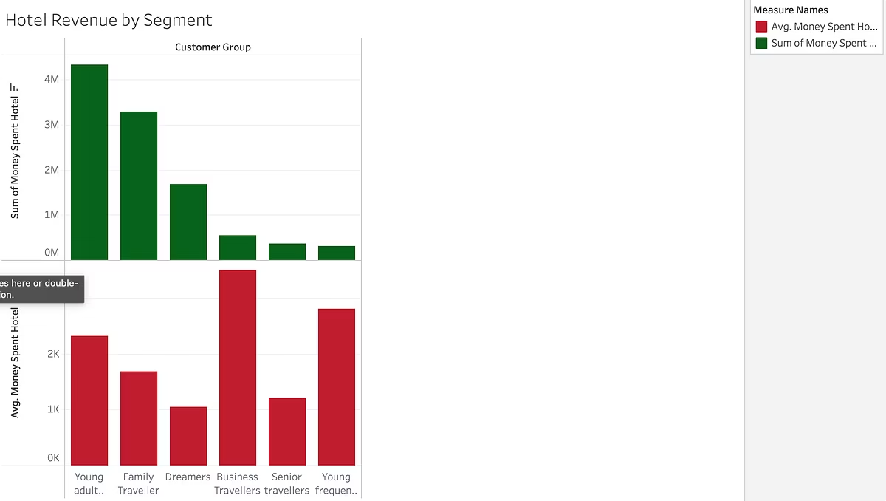
Hotel Revenue by Customer Segment
$4M
Young Adult Frequent Travellers
Highest total revenue
$3K
Business Travellers
Highest revenue per user
$2M
Family Travellers
Strong overall spend
Low
Dreamers
Low spending, need engagement

Slide 9


Conclusion
TravelTide’s customer segmentation reveals key insights for targeted marketing.
Understanding segment revenue, engagement, and perks aids in tailored strategies.
Focusing on high-value segments like Young Adult Frequent Travellers boosts impact.
Insight-Driven Engagement
Segment-Specific Revenue Growth
Align perks and communications with customer preferences to increase loyalty.
Prioritize strategies for segments with highest revenue potential.
Data-Backed Decisions
Leverage segmentation data continuously to optimize marketing efforts.

